Slide 1
Jesus said “Come and follow me and I will teach you how to fish for people”

Slide 2
Notes:
Who he calls: Incredible moment in salvation history
Start as he means to go on
Calling ordinary people
How he calls: fishers of men
What he calls them to:
To follow him To learn To fish

Slide 3
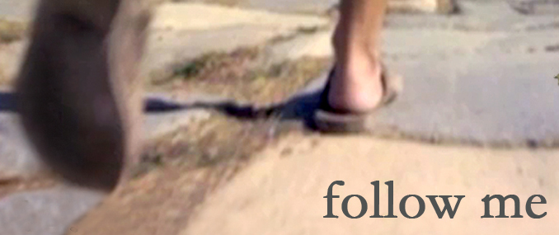
Notes:
Follow me Left nets – simplicity Somehow they saw something that would cause them to give everything up

Slide 4
Notes:
Learn
? Kid learning to walk

Slide 5
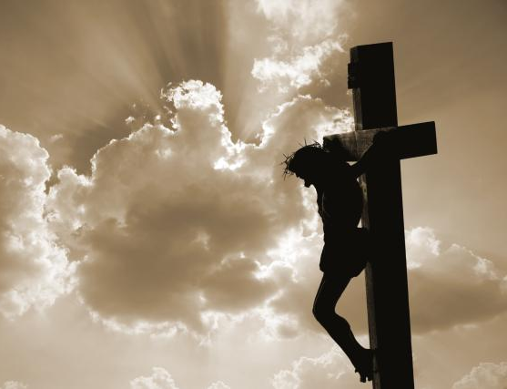
Notes:
In Jesus and his Gospel is the radical, life-altering, world-shaking assertion that the kingdom of God has arrived. The Good News that Jesus announced with his lips, demonstrated with his life, sealed on the cross, and inaugurated with his resurrection is nothing short of the reality that the reign of God is no longer just in heaven but is here on earth and available to all people. The Biblical story of the kingdom, has a shape and a goal that must be observed and to which appropriate response must be made.
If anyone wants to be my disciple they must deny themselves, take up their cross and follow me
Our identity is changed – that we are followers of Jesus

Slide 6
I have been crucified with Christ and I no longer live, but Christ lives in me. The life I now live in the body, I live by faith in the Son of God, who loved me and gave himself for me.
You are an ambassador of Jesus Christ.
Wherever you go, God is sending you;
Wherever you are, God has a purpose in your being there.
Christ, who indwells you, has something he wants to do through you.
Believe this and receive the blessing of his empowering presence.
Go in peace to love and serve the Lord
In the name of Christ. Amen!

