Slide 1
6 C’s of disciple-making
cultivating
conversion
continuing
compassion
connection
confidence

Slide 2
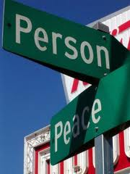
Continuing with your Person of Peace
Invitation: Challenge
friendship words of kingdom community works of kingdom Being available Talking about Faith Meeting up regularly Encounter God Inviting Offer to share Bible stories Sharing life Invite to Alpha Introducing to friends Lend books, CDs Allowing them to serve Read Bible, discuss issues

Slide 3
My story
There was a time in my life when . . .
Then I decided to . . . .
Now . . .

Slide 4
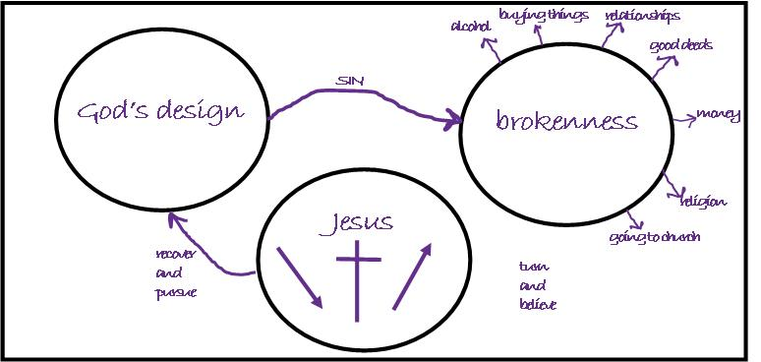
Conversion God’s story

Slide 5
Cultivating

