Slide 1
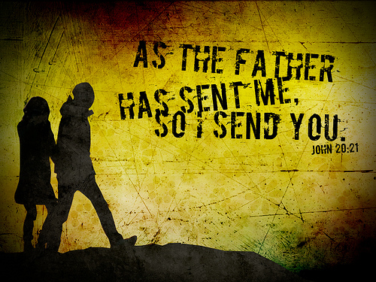

Slide 2
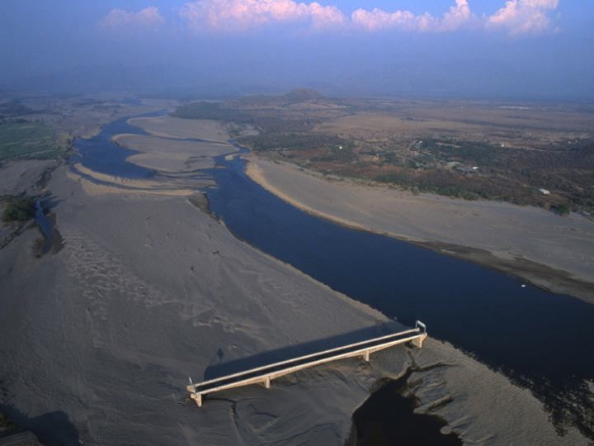
Notes:
You’re looking at a picture of the Choluteca Bridge in Honduras. It was taken right after Hurricane Mitch devastated the Caribbean in 1998.
as USA TODAY comments;
“The graceful arches of the New Choluteca Bridge stand abandoned, a white concrete sculpture far from shore, linking nothing to nowhere. The Choluteca Bridge itself is perfect… except that it now straddles dry land. Mitch changed the course of the Choluteca River, and there is water where the access roads used to be ... Now, there is no solution… it is very difficult to change the current. [The river] is in a totally different place.''

Slide 3
MISSIONAL CHURCH
+
MISSIONAL PEOPLE
=
MISSIONAL MOVEMENT

Slide 4
Pastoral Church v Missional Church
Pastoral Church
Missional Church
Congregation focus Sunday is the destination Seating capacity Fellowship groups Aim is to retain Leaders = rule keepers Prayer = needs focussed People fulfil programme Neat and tidy Static Finances for maintenance
Kingdom expansion Sunday is the launch pad Sending capacity Missional communities Aim is to release Leaders = risk takers Prayer = battle focussed Programme equips people Messy Movement Finances for mission

Slide 5
Jesus said, “Peace be with you! As the Father has sent me I am sending you.” And with that he breathed on them and said “Receive the Holy Spirit.”
John 20:21-22

Slide 6
Jesus came to them and said, “All authority in heaven and on earth has been given to me. Therefore go and make disciples of all nations, baptizing them in the name of the Father and of the Son and of the Holy Spirit, and teaching them to obey everything I have commanded you. And surely I am with you always, to the very end of the age.”

Slide 7
Jesus said, “You will receive power when the Holy Spirit comes on you and you will be my witnesses in Jerusalem and in all Judea and Samaria and to the ends of the earth.”
Acts 1:8

Slide 8
“Therefore, if anyone is in Christ, the new creation has come: the old has gone, the new is here! All this is from God, who reconciled us to himself through Christ and gave us the ministry of reconciliation: that God was reconciling the world to himself in Christ, not counting people’s sins against them. And he has committed to us the message of reconciliation. We are therefore Christ’s ambassadors, as though God were making his appeal through us.”
2 Corinthians 5:17-20

Slide 9
6 C’s of disciple-making
cultivating
conversion
continuing
compassion
connection
confidence

Slide 10
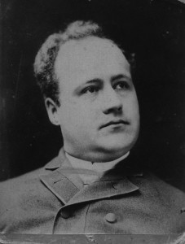
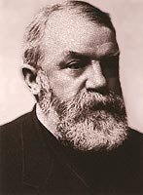
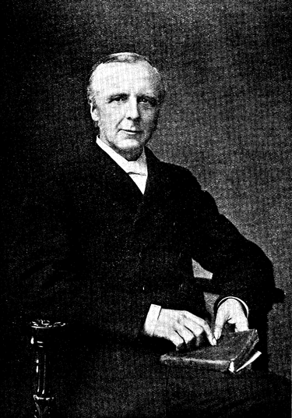
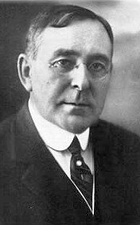
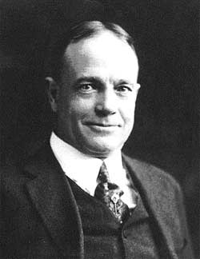
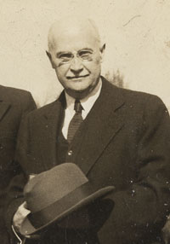
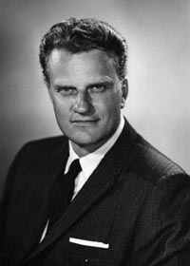
Edward Kimball D L Moody F B Meyer Wilbur Chapman
?
Billy Sunday Mordecai Ham Billy Graham

Slide 11
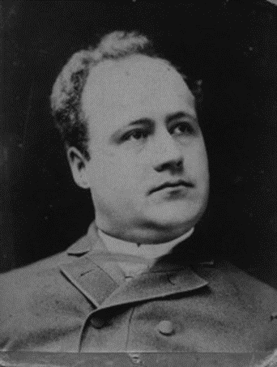
Edward Kimball

